Slide 1
TRACK LOCATION USING nodeMCU WITHOUT GPS
We are Jerome and Adeline ,students in internet of things in RWANDA.
We are going to show ,how we can get the location without GPS using nodeMCU.

Slide 2
The working principal
Fist of all we must have the nodeMCU connect to the laptop, the we install the Arduino software with some libraries unclude, ESP8266HTTP ,ArduinoJson,ESP8266wifi,then we found the Google’s Geolocation API. we will put this API key in the codes. will help us to get the google map data.after running the program we will get the longitude and latitude.

Slide 3
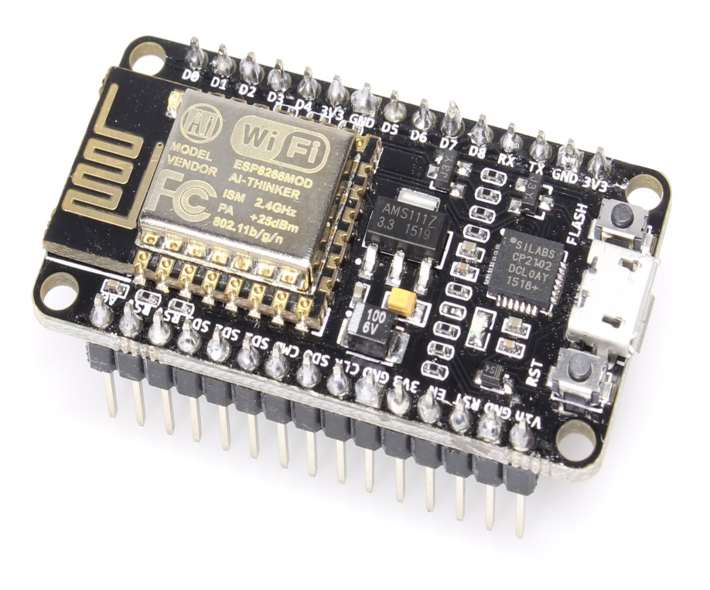
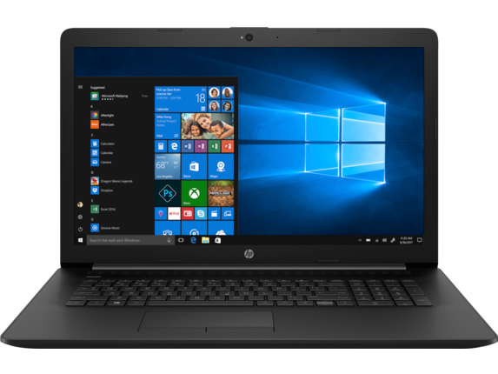
THE MATERIALS WE NEED
ESP8266 board
laptop

Slide 4
The procedures for getting Google’s Geolocation API.
Get the API key
You must have at least one API key associated with your project.
To get an API key:
Go to the Google Cloud Platform Console.
From the Project drop-down menu, select or create the project for which you want to add an API key.
From the Navigation menu, select APIs & Services > Credentials.
On the Credentials page, click Create credentials > API key. The API key created dialog displays your newly created API key (an encrypted string).
Click Close.
After getting the geolocation API, put it in the code

Slide 5
Programming NodeMCU for getting GPS data
We will use Three libraries
-ESP8266HTTPClient
- ArduinoJson
- ESP8266WiFi .

Slide 6
#include <ESP8266HTTPClient.h>
#include <ArduinoJson.h>
#include "ESP8266WiFi.h"
// your network SSID (name) & network password
char myssid[] = "ClementRegi4";
char mypass[] = "44448888";
// unwiredlabs Hostname & Geolocation Endpoint url
const char* Host = "www.unwiredlabs.com";
String endpoint = "/v2/process.php";
// UnwiredLabs API_Token. Signup here to get a free token https://unwiredlabs.com/trial
String token = "ee5dbe6ded8a53";
String jsonString = "{\n";
// Variables to store unwiredlabs response
double latitude = 0.0;
double longitude = 0.0;
double accuracy = 0.0;…………………………………

Slide 7
Open the Google maps using your smartphone or laptop and enter the latitude and longitude disjointed by comma , You will get your location on the map .

Slide 8
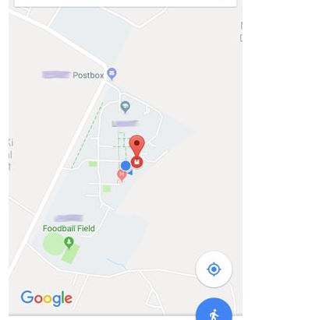
The Google map show the location

Slide 9
This is our link on the YouTube
This is our link on the YouTube
https://www.youtube.com/watch?v=W2yQoJ6_qb0&feature=youtu.be

